Slide 1





Content Audit Insights
1.Ugam has run content audit for sample of 10 SKUs from the A list of products shared by Target
2.Identified areas of content improvement
October 2013
Private & Confidential

Slide 2
Agenda
Solution Walk-through for 12 SKUs compared across 3 competitors Amazon, Walmart & Sears
Next steps

Slide 3
Solution walkthrough…

Slide 4
List of products we worked upon…
ProductID | Product Name | Category | Amazon | Walmart | Sears
14034728 | Graco Mason 4-in-1 Convertible Crib - Es | Baby and Toddler Furniture | √ | × | √
13370392 | Graco Secure Coverage Digital Baby Monit | Baby Essentials | √ | √ | √
14527059 | Furby Boom Figure - Waves | Girls toys | √ | √ | √
13795489 | Conai Infiniti Pro Crlng Iron 1.5" Black | Haircare | √ | √ | ×
11546000 | Cool Mist Humidifier Pink 0.9 Gallon | Health And Wellness/Vitamins | √ | √ | √
14004263 | Samsung 50" 1080p 60Hz LED HDTV - Black | Home Electronics | √ | √ | √
11852371 | OK to Wake! Alarm Clock and Night-Light | Kids Home | √ | √ | √
11154576 | WEBER Smokey Mountain Cooker Black 18.5" | Lawn & Garden | √ | √ | √
10057202 | Philips Sonicare HX5610/01 Essence 5600 | Personal Care and Household Co | √ | × | √
14213695 | 16GB Apple iPad Mini | Portable Electronics | √ | × | √

Slide 5




Here is how our analysis of the sample products pans out…
Content Score*
46
*On a scale of 1 to 100, higher scores are better.

Slide 6
Does Content Matter?
Keeping price in the same ball-park range, product pages that have better content (in terms of images, videos, keyword infusion etc.) have a higher probability of doing well

Slide 7
Target has scored well on basic content compared to Amazon & Walmart however as it progresses to conversion and traffic content the scores are dropping.
*100 is a cumulative score calculated after adding weightage for each parameter.
͂Parameter considered here are based on descriptive analysis, we have also referred to some research papers

Slide 8
Do you want to see how many A+ products pages you have…
Target does not have any product falling under “-D” grade, 20% in “D”, 20% in “C”, 50% in “B” and 10% in A grade. None of the products are falling under “A+” grade.

Slide 9
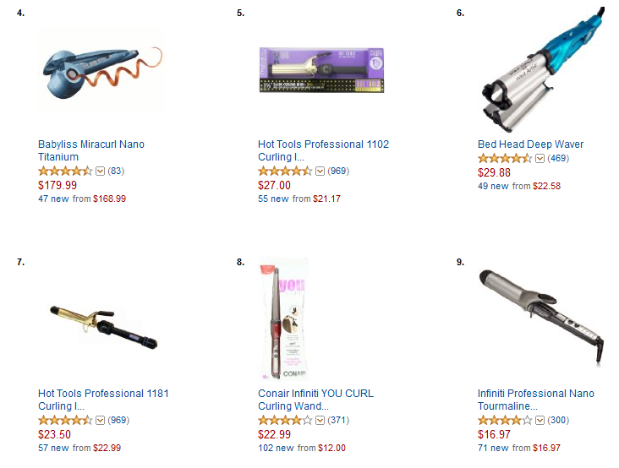
A Best Seller Product
Currently #9 on Amazon Bestseller in Curling Irons

Slide 10
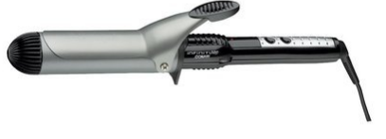

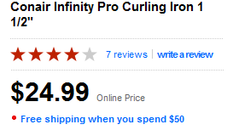
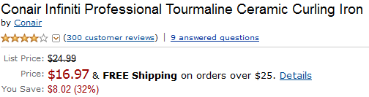
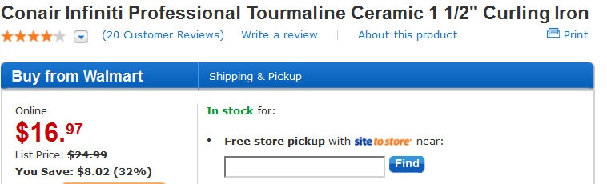
Target is lacking behind on content compared to Amazon and Walmart…
Conair Infinity Pro Curling Iron 1 1/2"
Content Score | 23 | 63 | 41
Price | $24.99 | $16.97 | $16.97

Slide 11
Target is lacking behind on primary content assets that are traffic or conversion multipliers…
Conair Infinity Pro Curling Iron 1 1/2"
Images | 1 | 6 | 1
Specification | Available | Available | Available
Words in copy | Not Available | 246 | 157
Reviews Available | Available | Available | Available
Meta Keywords | Available | Available | Available
Meta Title | Available | Available | Available
Meta Description | Available | Available | Available
High resolution images (>=1500 px) | 810p x 810p | 1500p x 1194p | 500p x 500p
Videos | Not Available | Not Available | Not Available
# of Reviews | 7 | 297 | 17
Ratings | 4 | 4 | 4.1
Description length | Not Available | 246 | 157
Estimated Click-through rate (%) | 0% | 6% | 3%
Google Plus | 0 | 1 | 0
Likes, Tweets, Pins | 1 | 193 | 4
Meta Keyword1 present in Product Description | Not Available | Available | Available
Meta Keyword2 present in product Description | Not Available | Available | Available
Meta Keyword3 present in product Description | Not Available | Available | Available
Notes:
http://www.amazon.com/Jabra-EASYGO-Bluetooth-Headset-Packaging/dp/B0042X8XJ6
http://www.sears.com/jabra-easygo-universal-bluetooth-174-mono-headset/p-00303250000P?prdNo=9
http://www.staples.com/Jabra-Easy-Go-Bluetooth-Headset/product_923681
http://www.officemax.com/technology/wireless-phone-accessories/bluetooth-headsets/product-prod4090150?R=23391198&ssp=true&useSessionResults=false&searchTerm=amFicmEgZWFzeWdvIGJsdWV0b290aCBoZWFkc2V0&csRedirectSearchString=jabra%20easygo%20bluetooth%20headset&csSearchTag=true&csRedirectSearchResultCount=1
http://www.officedepot.com/a/products/193129/Jabra-EASYGO-Earset/

Slide 12
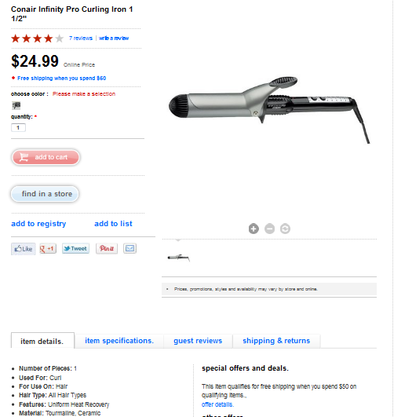
Some of the Basic & Conversion multiplier content components are either missing or insufficient
Infinity spelled incorrectly…it should be “Infiniti”. Most prominent feature should be included.
Multiple images missing and the existing one is not a high resolution image.
Product video is missing
Product description is missing.
Detail Specification/Long copy containing feature-benefit oriented bullets are missing

Slide 13
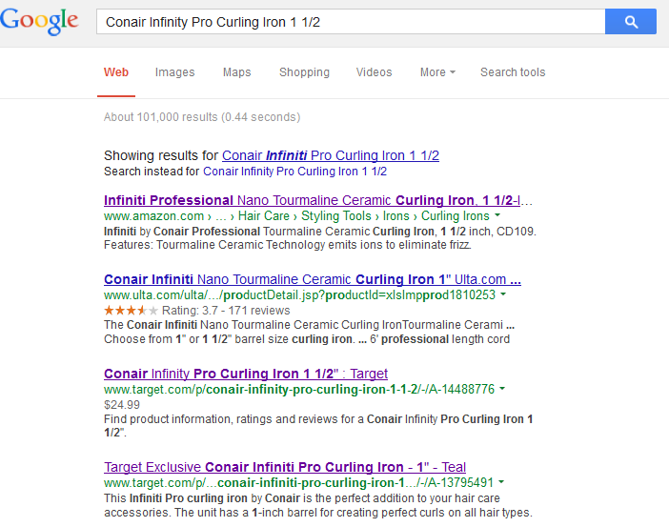
Traffic Multiplier Content: Meta content analysis
1st Meta keyword is same as product title..in rest of the keywords few words are added like reviews, product ratings. And some keywords are generic like Beauty, Hair care which is more associated with category pages.
Target is appearing on 3^{rd p}osition

Slide 14
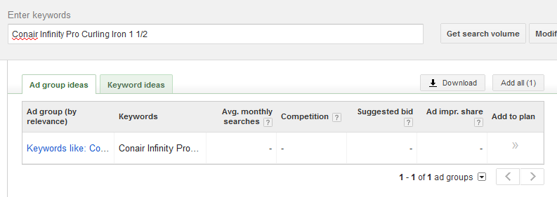
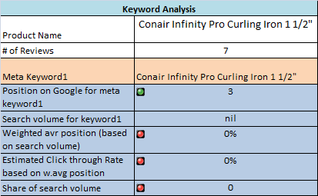
Though Meta content is not the only way to get traffic it is equally important to have the right keyword selection for being Discovered by Relevant traffic
This keyword does not have any search volume as there are no users searching for it explicitly
Though you are appearing on 3rd position for this keyword there is no search volume available for it….if your traffic is low on the page please consider this as one of the reason…

Slide 15
Keyword analysis continued…
Meta Keywords | Conair Infinity Pro Curling Iron 1 ½” | Conair Infinity Pro Curling Iron 1 1/2" reviews | Conair Infinity Pro Curling Iron 1 1/2" product ratings | beauty | hair care | hair styling tools | Target
Position on Google for meta keywords leading to the specific product page | 3 | 4 | 0 | 0 | 0 | 0 | 0
Search volume for keyword1 | 100 | 0 | 0 | 246000 | 33100 | 1900 | 16600000
Weighted avr position (Position*search volume/search volume) | 0% | 0% | 0% | 0% | 0% | 0% | 0%
Estimated Click through Rate based on w.avg position | 0% | 0% | 0% | 0% | 0% | 0% | 0%
Ideally there should be 3 to 5 keywords per page here it is 7. First 3 keywords are product specific and has good position on Google however there is zero search volume for it…
Last four keywords are category specific and except “Target” for rest of the keywords Target doesn’t appear anywhere on first 20 results even though the search volume is very high…

Slide 16
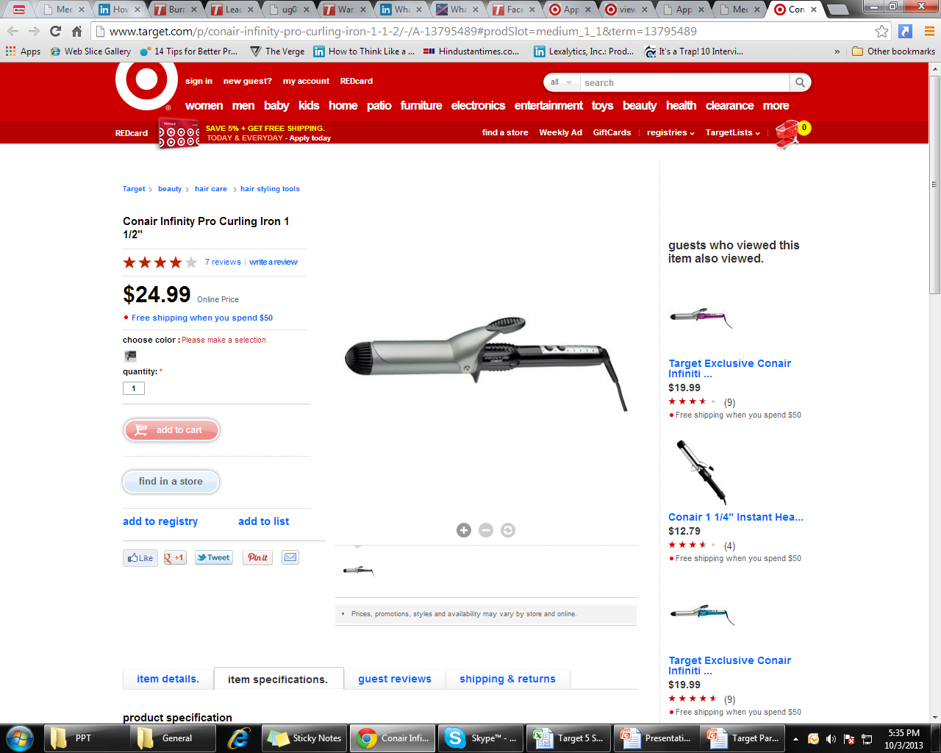
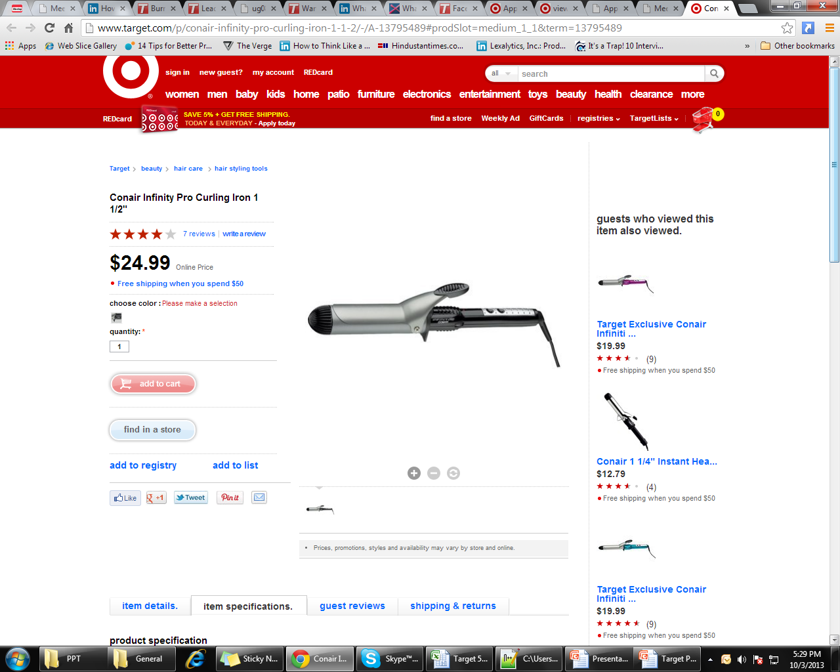
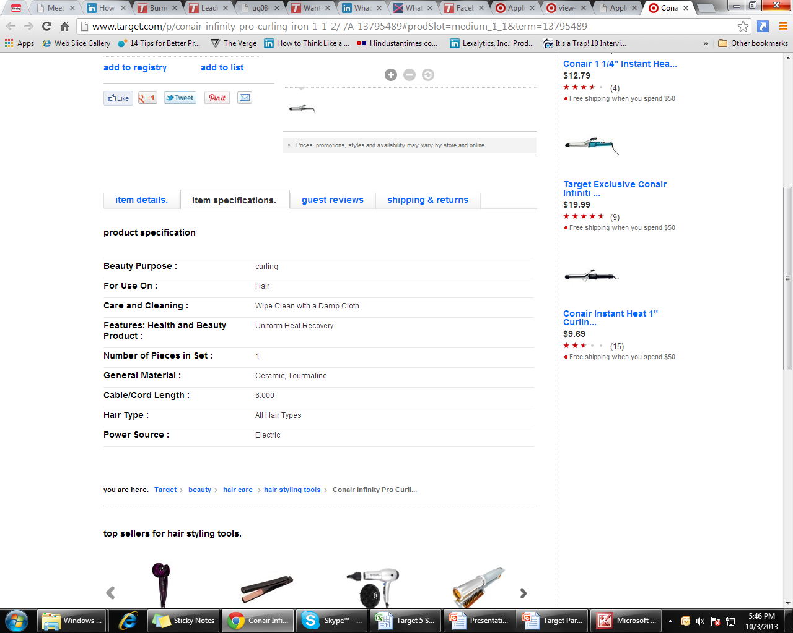
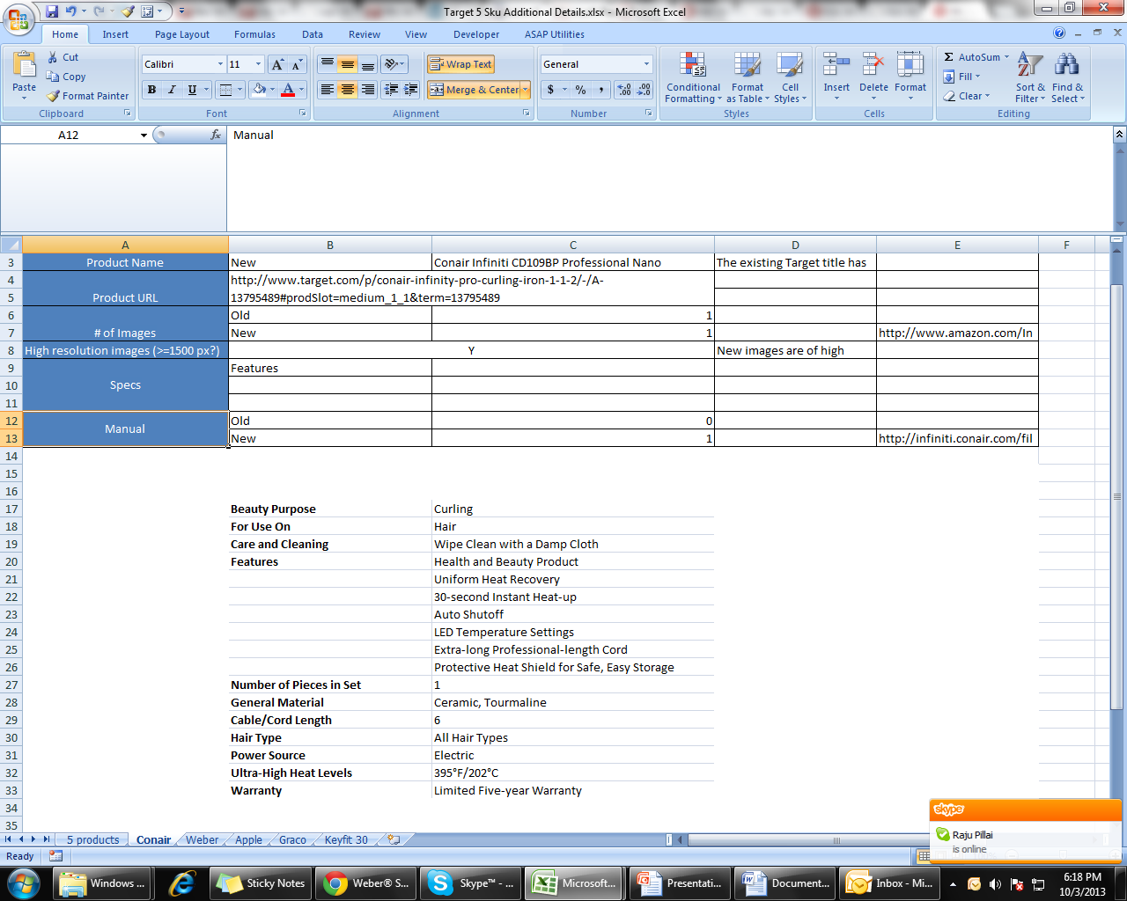
Ugam’s version of optimized content…
Conair Infiniti CD109BP Professional Nano Tourmaline Ceramic 1½" Curling Iron
Title updated by Ugam
Updated Specifications

Slide 17
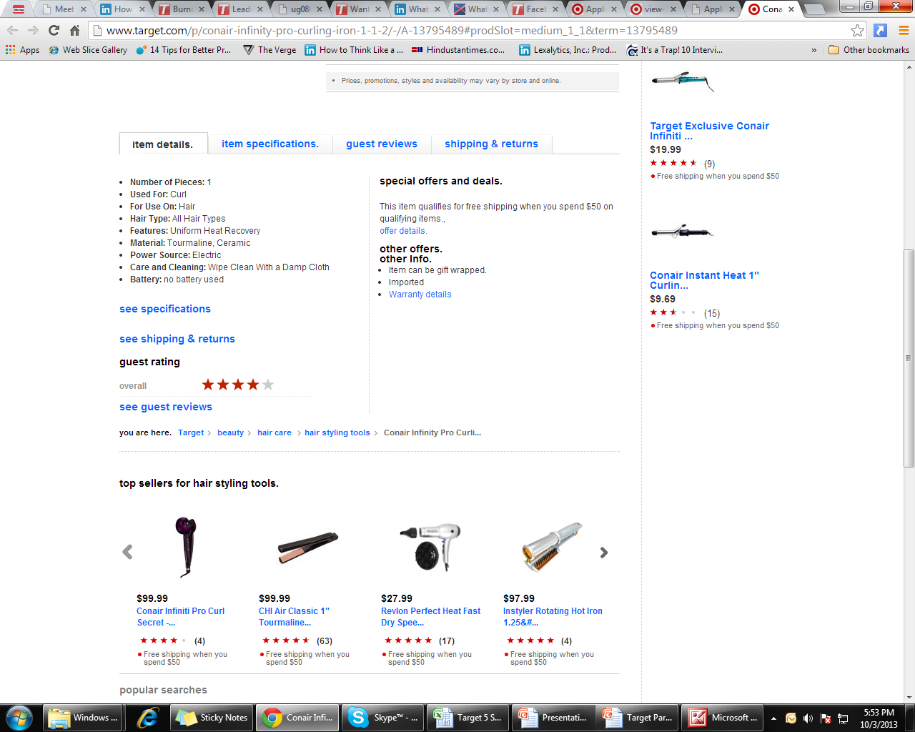
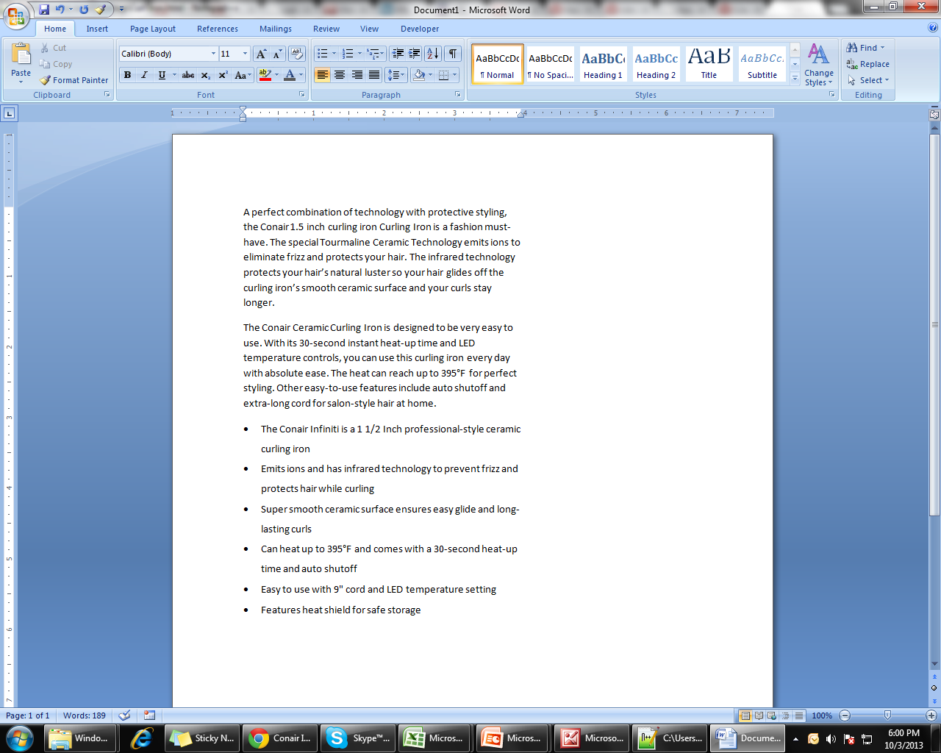
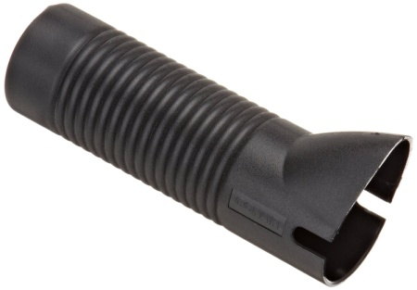
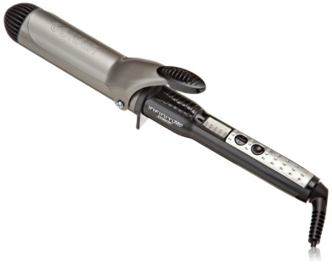
Updated Product Description with Feature Bullets
Additional Images and Product Manual

Slide 18
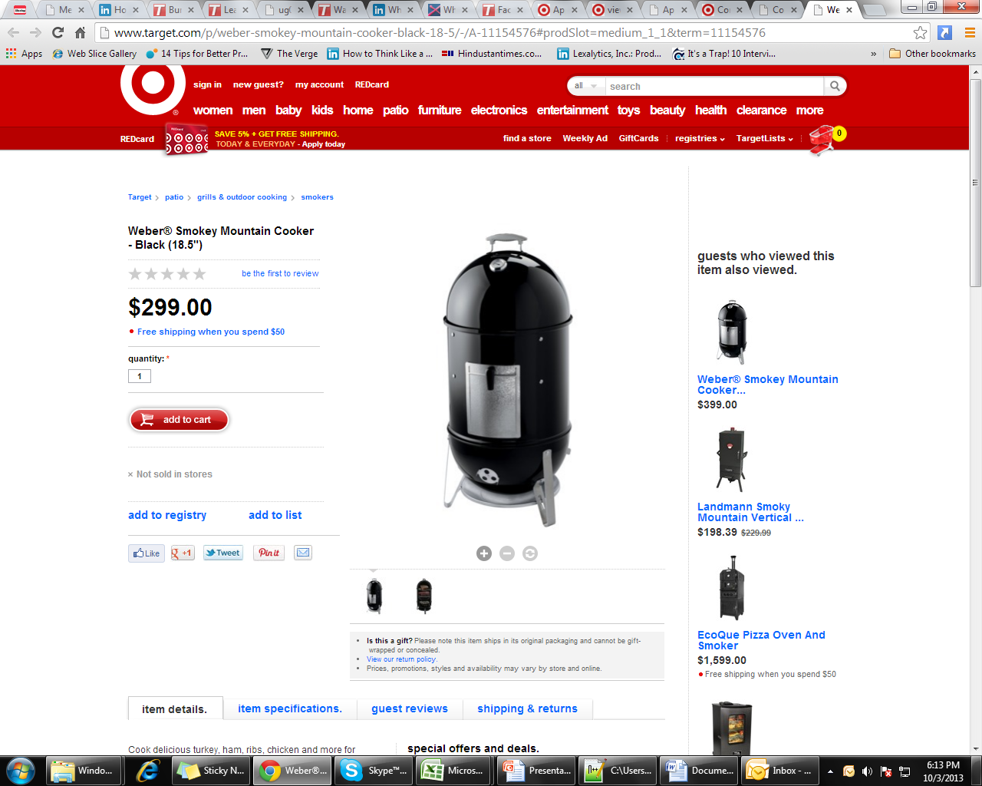
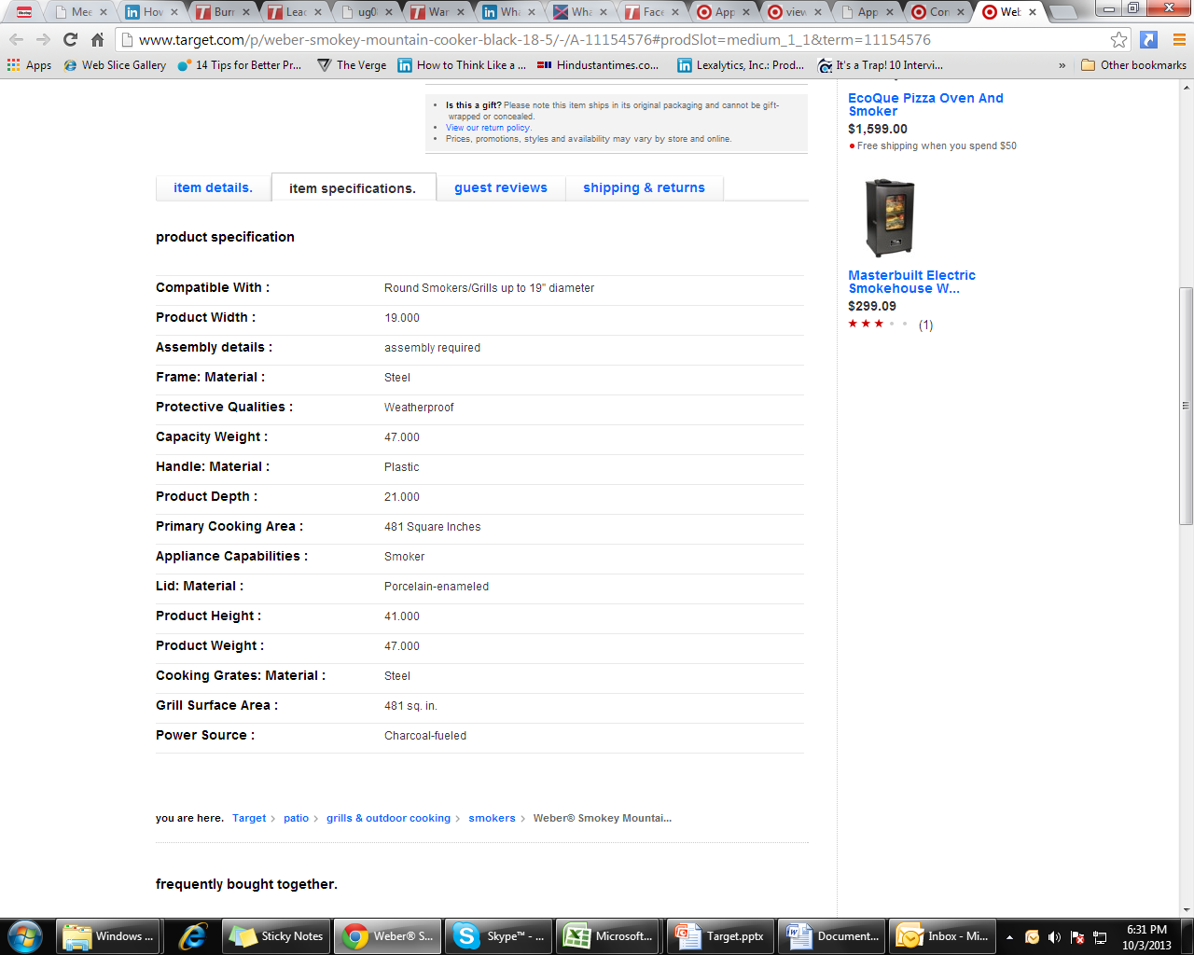
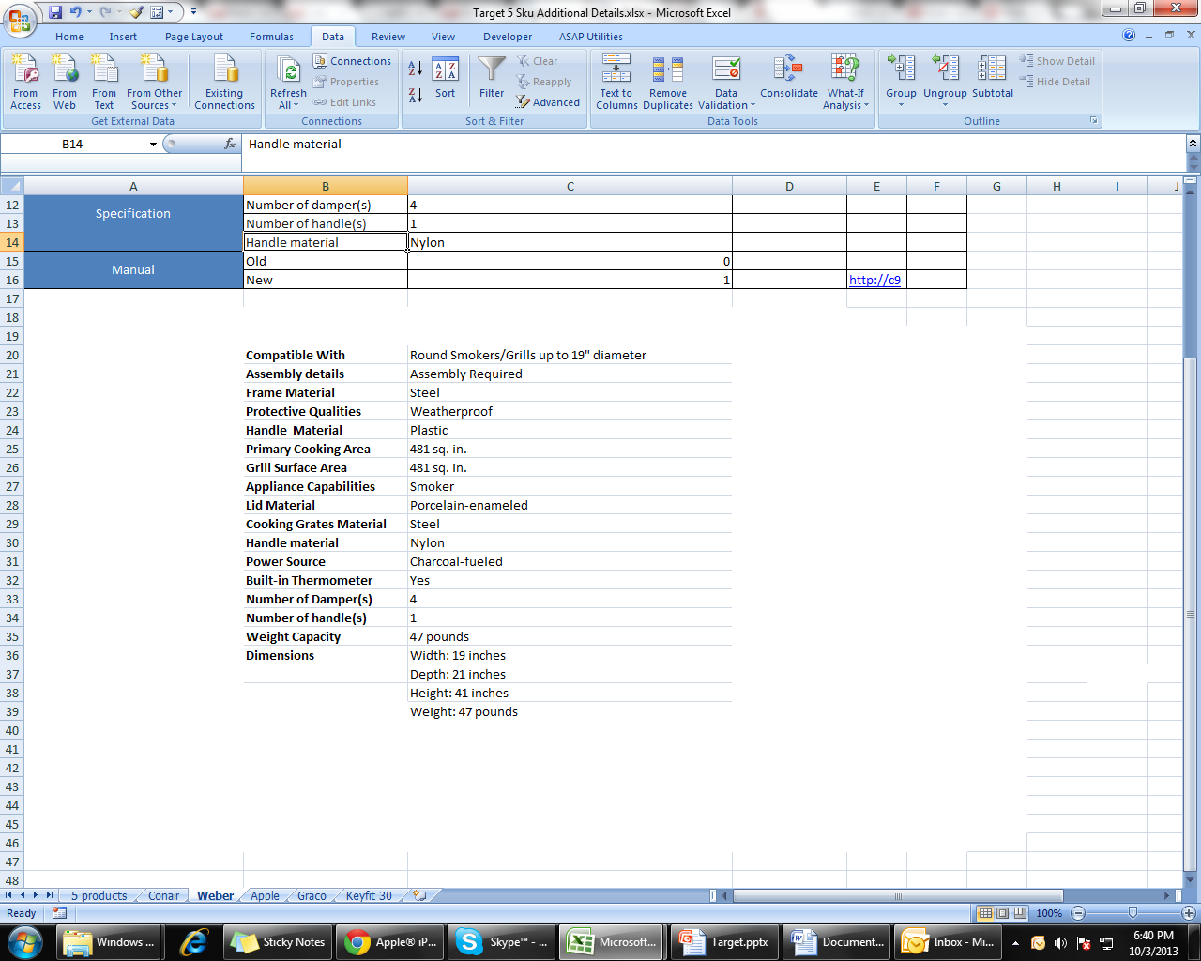
Weber® Smokey 721001 Mountain Cooker 18.5", Black
Weber® Smokey 721001 Mountain Cooker 18.5", Black
Title updated by Ugam
Updated Specifications

Slide 19
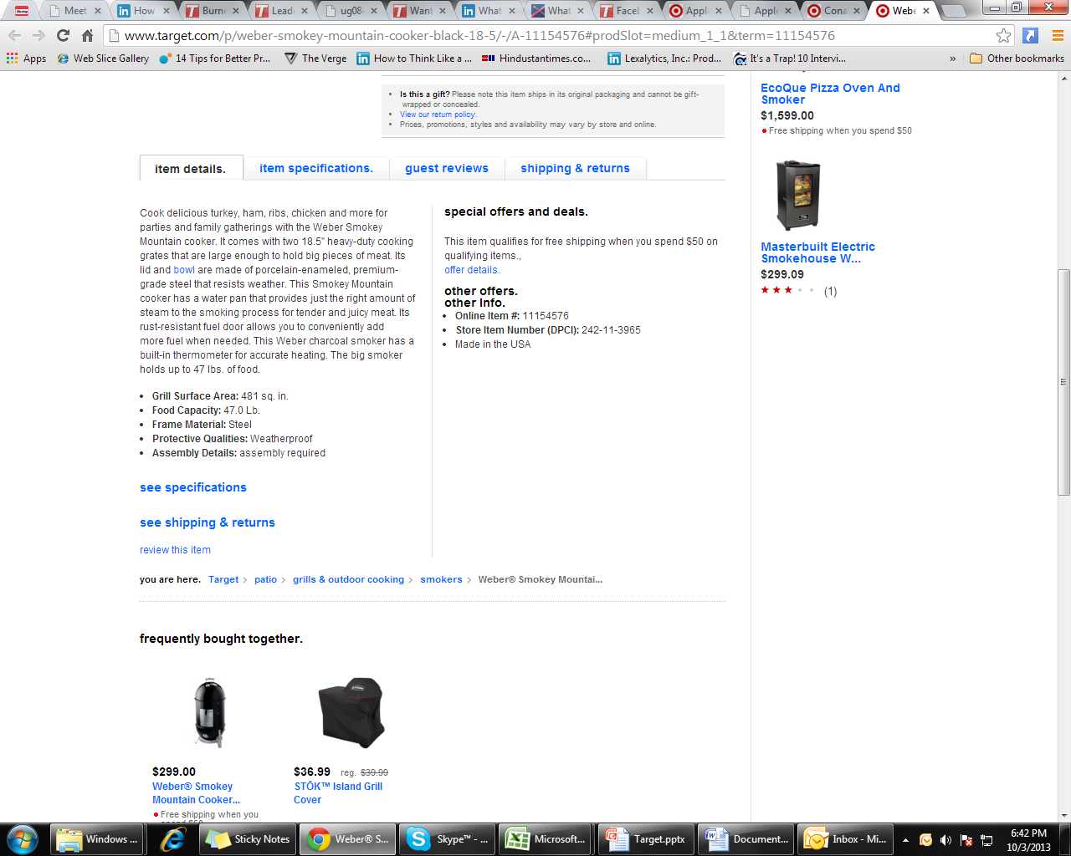
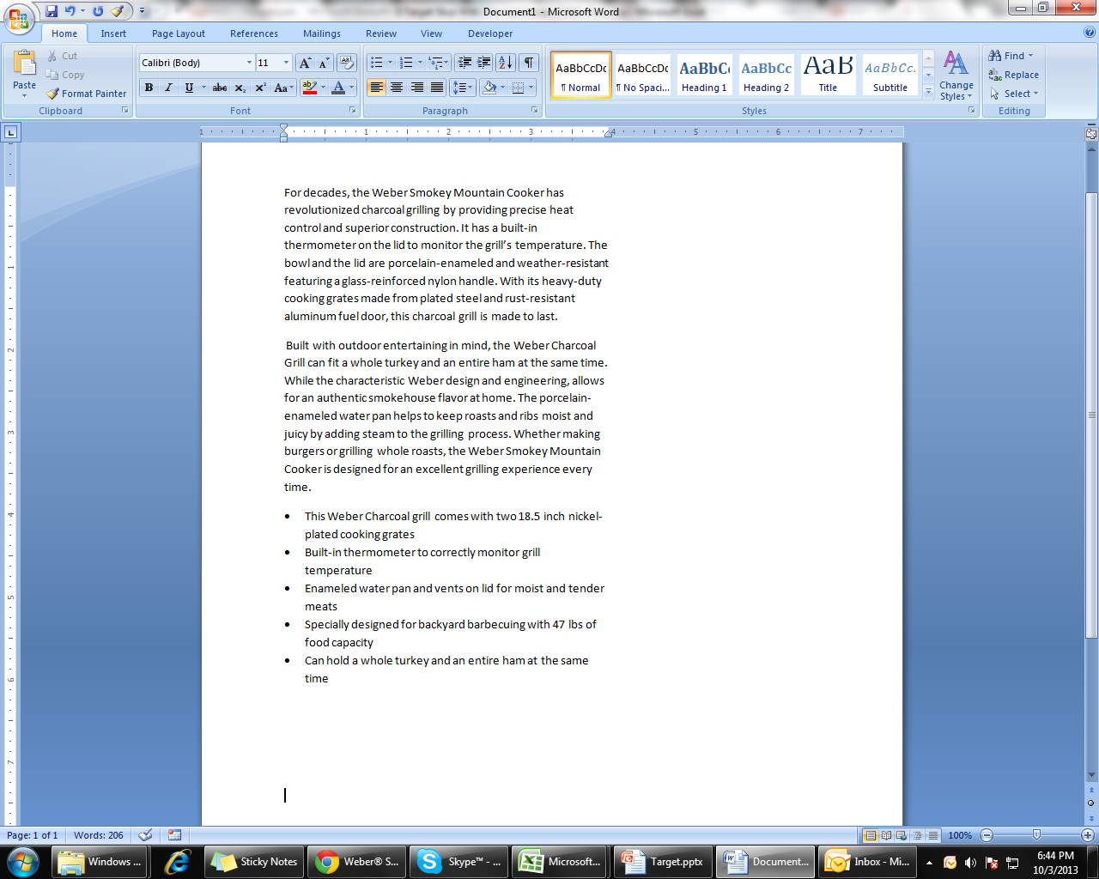
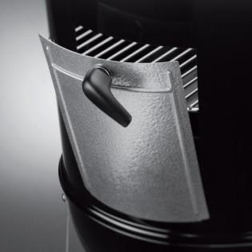
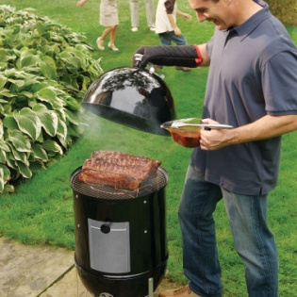
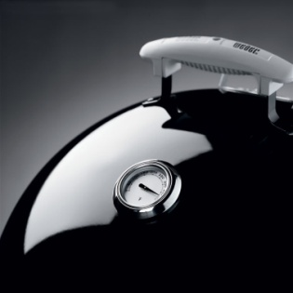
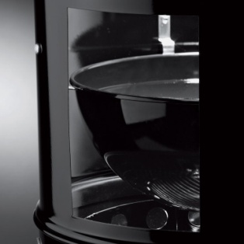
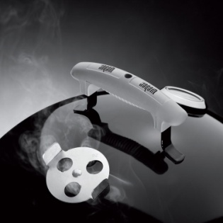
Weber® Smokey 721001 Mountain Cooker 18.5", Black
Updated Product Description with Feature Bullets
Updated Product Description with Feature Bullets
Additional Images and Product Manual

Slide 20

Organic search graph

Slide 21
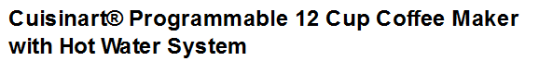
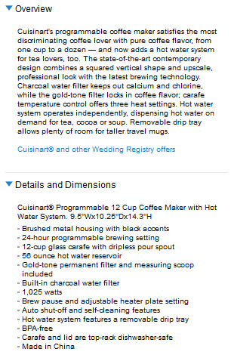
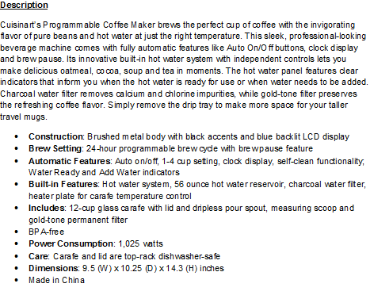
Basic content enrichment will help…
Suggested: Short copy 119 words. Feature-benefit oriented bullets provided
WIP – Will create similar insights for Target products
Existing: Short copy less than 100 words. Feature-benefit oriented bullets missing!

Slide 22




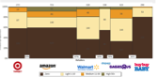
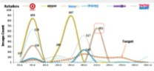
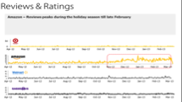



Know and act on your content gaps to improve conversion
Audit
Benchmark
Cure
Retailers measure site speed, web traffic, shopper satisfaction and host of other metrics. However, there is no existing source of reliable insights on online product content completeness or content strategy.
That's where Content ABC comes in. Content ABC helps retailers assess where they stand as regards their online product content and fix the content gaps to improve content experience enabling better conversion.
Retailers may need to pay more attention to the content of their best sellers, Content ABC also allows for such custom content analytics to focus the content budget to get a better return on investment.
Deep Mining. To help sharpen your category decisions
Be Assured. We have been delighting who’s who across categories
Unmatched Accuracy to power winning pricing decisions

Slide 23
Next Steps?
1
Content Audit for all the A list products
2
Uncover Actionable insights
3
Roll-out to large set of data

Slide 24
Thank you
Ugam Solutions provides actionable analytical insights and product content to the retail industry. Our clients include 9 of the Top 25, from the Internet Retailers’ 500. Powered by a Big data analytics platform, analytics experts and domain specialists, our solutions enable winning decisions.
For more information, contact:
info@ugamsolutions.com

